Slide 1
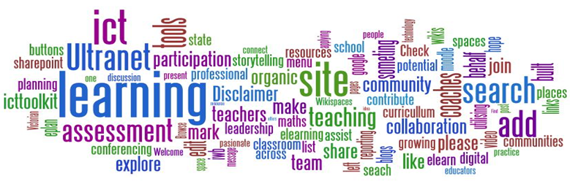
Cambridge TECHNICALS LEVEL 3
2016
2.1 - Understand where information is held globally and how it is transmitted

Slide 2
RELATED ACTIVITIES
e
This unit | Title of suggested activity | Other units/LOs
LO1 | Types of information storage media Accessibility of world wide web information formats | Unit 18 Computer systems hardware | LO1 Understand the components of a computer system
 |  | Unit 2 Global information | LO1 Understand where information is held globally and how it is transmitted LO4 Understand the legal and regulatory framework governing the storage and use of global information LO5 Understand the process flow of information LO6 Understand the principles of information security

Slide 3
RELATED ACTIVITIES
e
Explanations of the key terms used within this unit, in the context of this unit
Data | Data is information that has been coded and structured in some way, ready for processing, storage, transmission, etc. Data has no context and has no meaning. Examples of data could include: shoe size stored in the stock database of a shop, a date, etc.
Global divide | The divide that exists in terms of access to information between different countries and different types of holders of information across the world.
Green IT | The practice of reducing energy use by IT equipment and thus improving sustainability. This relates to both individuals and organisations. The main purpose of Green IT is to increase the sustainability of IT equipment and operations. Examples of Green IT range from an individual using their PC power settings to automatically switch off the screen after a certain time with no keyboard/mouse activity, up to the virtualisation of a large, global organisation’s data stores to reduce the number of servers in their data centres.
Holder of information | Any individual or organisation that holds information
Information | Information is data that has been given context and meaning in some way (e.g. by processing, storing or transmission). An example of information is: a shop receipt showing the model, price and size of shoes, together with the time and date of the purchase
Information formats | The different ways in which information can be presented using world wide web (www) technologies. Examples of information formats are: web pages; RSS feeds; podcasts; blogs; and social media channels.
Information style | The style of information, regardless of the technology used. For example, the audio information style could be represented by spoken instructions, an MP3 music file, a DVD soundtrack or a podcast. Many, but not all, of the information styles will have a corresponding information format on the world wide web.

Slide 4
Assignment Scenario
There are 9 sections to this Theory Unit, each of which will give you a basic understanding and practice at possible exam questions. It will involve gaining knowledge towards the answers.
This is not a wrote learning course, you will need to understand the basics of ICT in order to adapt your knowledge towards companies and their needs. For LO1, this will involve understanding:
Holders of information.
Types of information storage Media
Types of information access and storage devices
The Internet
Types of world wide web technology networks
World wide web information Formats
Accessibility of world wide web information formats
Advantages and disadvantages for individuals of world wide web information formats
Comparison of technologies
In the exam you will be given precise questions requiring precise answers based on a scenario to answers questions from, and adapt your knowledge and use the key terms and named components to give a judgemental answer.

Slide 5
1.1 – Holders of Information – Information Variety
They say that information is key, the lifeblood of an organisation, without it a company works alone, independent of the outside world, immune to trends, to sales projections, to the changes in customers and opinions, to advances in technology. Information is power, and a critical resource for performing within organisations.
Business managers spend most of their day in meetings, reading, writing, and communicating with other managers, their staff, customers, suppliers, and other business associates via telephone, in person, or by e-mail. The management function itself is information processing. It involves gathering, processing, and disseminating information. Managing information involves coping with a wide range of information sources before finally making decisions about what to do with it.
A manager must track and react to information flowing from sources inside and outside the business. The manager processes this river of information and disseminates it in one of four ways: stores it, uses it, passes it on, and/or discards it, e.g., during the course of a normal business day, a marketing manager for an IT company receives information in the form of e-mail, telephone calls, letters, reports, memos, trade publications, and formal and informal conversations.
All these are used to benefit the company and they better they are processes, the faster, the more usable and readable the format, the better the business function.
Different kinds of information in the world Different kinds of information within the departments of a company How easy it is to access information now With phone and portable internet, all information is instant How can Apps change what we read Is there an App for everything.

Slide 6
1.1 – Holders of Information – Information Variety
Interpretation differences – What a company or government or other intends to do with the information will also dictate what kind of information they will be looking for. If I am to place it in a report than it can be quite detailed, if it is to be shown in a chart form then it needs to be quantitative, if it needs to be seen then pictorial form. The output medium can limit then amount of information shown and limit the method to Sound, Video, Textual, Financial or Opinion based.
Time sensitive – On a global scale, time is everything, especially money. Time can restrict the method by rushing it for publication, email rather than posted, it can hasten the interpretation f it is necessary to act upon right away, it can change how different companies manage the information depending on their ability to interpret it quickly. E.g. share trading relies on information being instant, within a fraction of a second, money depends on it. Whereas climate change or foreign policy changes slowly.
Task 2 – Choose a country outside Europe and North America and research the following information:
Change in the last 10 years of its primary food product exports.
Change in the last 10 years of its imports of American goods
Change in the last 10 years of the country’s population under 16
Change in the last 10 years in the country’s employment rates
Currency changes between the country and the Euro.
Political changes (leadership)within that country.
Present this information in a form that analyses trends and a relationship between this information.
Different kinds of information in the world Different kinds of information within the departments of a company How easy it is to access information now With phone and portable internet, all information is instant How can Apps change what we read Is there an App for everything.

Slide 7
1.1 – Holders of Information – Owners
Within every company there are different holders of this information and they will gather, interpret and present this information in different ways. Within a standard average sized business you can expect to see the following department:
Consider a single piece of information, such as a new product released onto the market by a direct competitor which is smaller, faster and better than your product.
Then consider how each of these departments (holders of the information) will receive, interpret and react to this information.
Task 3 – Choose a company and for all 10 departments, create a report on how they will manage the information about change.
There are different kinds of owners of information such as Individual citizens, businesses, educational institutions, governments, charities, health care services and community organisations) and their location could be anywhere around the world.
Task 4 – Repeat the same task as Task 3 but for one of these other owners of information and how they would react to information change.
Different kinds of information in the world Different kinds of information within the departments of a company How easy it is to access information now With phone and portable internet, all information is instant How can Apps change what we read Is there an App for everything.
Sales | Finance | Marketing
Purchasing | Research and Development | Administration
Operational | Human Resource Management | Production
 | Competitor Analysis

Slide 8
1.2 – Types of information storage media - USB
There are multiple different kinds of storage medium depending on how much the user needs to store, how fast it needs to be done and for what purpose it needs storing. The most common of these are USB memory sticks, Hard Drives (internal and external, Cloud Storage, Network Storage, SSD, Tape Drives and DVD storage.
USB flash drive - This is a data storage device that includes flash memory with an integrated USB interface. USB flash drives are typically removable and rewritable, and physically much smaller than an optical disc. Some allow up to 100,000 write/erase cycles, depending on the exact type of memory chip used, and have a 10-year shelf storage time.
They come in a variety of sizes and shapes, usually multiples of 4gb.
USB flash drives are often used for the same purposes for which floppy disks or CDs were once used, i.e., for storage, data back-up and transfer of computer files. They are smaller, faster, have thousands of times more capacity, and are more durable and reliable because they have no moving parts.
USB drives with USB 2.0 support can store more data and transfer faster than much larger optical disc drives like CD-RW or DVD-RW drives and can be read by many handheld devices such as smartphones and tablet computers, though the electronically similar SD card is better suited for those devices.
A flash drive consists of a small printed circuit board carrying the circuit elements and a USB connector, insulated electrically and protected inside a plastic, metal, or rubberized case which can be carried in a pocket or on a key chain.
Being without a USB stick now is rare Capacity is growing but size is shrinking !5 years ago 256mb was considered large SD cards are similar but smaller. Can be used as key loggers Becoming more discreet Are banned from a lot of government buildings.

Slide 9
1.2 – Types of information storage media - HDD
Hard Drives (HDD) - These are the most common devices for storage in computer use. A hard disk drive (HDD), hard disk, hard drive or fixed disk[b] is a data storage device used for storing and retrieving digital information using one or more rigid rapidly rotating disks (platters) coated with magnetic material. The platters are paired with magnetic heads arranged on a moving actuator arm, which read and write data to the platter surfaces.[2] Data is accessed in a random-access manner, meaning that individual blocks of data can be stored or retrieved in any order and not only sequentially. HDDs are a type of non-volatile memory, retaining stored data even when powered off.
The primary characteristics of an HDD are its capacity and performance. Capacity is measured in terabyte (TB) drive or gigabytes (GB). Typically, some of an HDD's capacity is unavailable to the user because it is used by the file system and the computer operating system, and possibly inbuilt redundancy for error correction and recovery.
Performance is specified by the time required to move the heads to a track or cylinder (average access time) plus the time it takes for the desired sector to move under the head (average latency, which is a function of the physical rotational speed in revolutions per minute), and finally the speed at which the data is transmitted (data rate).
The two most common form factors for modern HDDs are 3.5-inch, for desktop computers, and 2.5-inch, primarily for laptops. HDDs are connected to systems by standard interface cables such as PATA (Parallel ATA), SATA (Serial ATA), USB or SAS (Serial attached SCSI) cables.
Being without a USB stick now is rare Capacity is growing but size is shrinking !5 years ago 256mb was considered large SD cards are similar but smaller. Can be used as key loggers Becoming more discreet Are banned from a lot of government buildings.

Slide 10
1.2 – Types of information storage media - Cloud
Cloud Storage – This is becoming more common, specifically within work and those who work from home. Cloud storage is a form of data storage in which the digital data is stored in logical pools, the physical storage spans multiple servers, and the physical environment is typically owned and managed by a hosting company. These cloud storage providers are responsible for keeping the data available and accessible, and the physical environment protected and running. People and organisations buy or lease storage capacity from the providers to store user, organization, or application data.
Advantages
Companies need only pay for the storage they actually use.
Organisations can choose between off-premises and on-premises cloud storage options.
Storage availability and data protection is paramount to cloud storage companies, so depending on the application, the additional technology, effort and cost to add availability and protection can be eliminated.
Storage maintenance tasks, such as purchasing additional storage capacity, are offloaded to the responsibility of a service provider.
Cloud storage provides users with immediate access to a broad range of resources and applications hosted in the infrastructure of another organization via a web service interface.[14]
Cloud storage can be used as natural disaster proof backup, as normally there are 2 or 3 different backup servers located in different places around the globe.
Being without a USB stick now is rare Capacity is growing but size is shrinking !5 years ago 256mb was considered large SD cards are similar but smaller. Can be used as key loggers Becoming more discreet Are banned from a lot of government buildings.

Slide 11
1.2 – Types of information storage media - NAS
Network Storage (NAS) – This is a file-level computer data storage server connected to a computer network providing data access to a large group of clients. NAS is specialised for serving files either by its hardware, software, or configuration. NAS systems are networked appliances which contain one or more storage drives, often arranged into logical, redundant storage containers or RAID.
NAS removes the responsibility of file serving from other servers on the network. They typically provide access to files using network file sharing protocols. NAS devices began gaining popularity as a convenient method of sharing files among multiple computers. Potential benefits of dedicated network-attached storage, compared to general-purpose servers also serving files, include faster data access, easier administration, and simple configuration.
For home this would mean storing all your music, videos, games etc. and streaming them across any compatible device.
Being without a USB stick now is rare Capacity is growing but size is shrinking !5 years ago 256mb was considered large SD cards are similar but smaller. Can be used as key loggers Becoming more discreet Are banned from a lot of government buildings.

Slide 12
1.2 – Types of information storage media - SSD
Solid State Drives (SSD) are rapidly taking over from HDDs/ They have no moving parts and all data is retrieved at the same rate no matter where it is stored. They don’t rely on magnetic properties; the most common type of solid state storage devices store data by controlling the movement of electronics within NAND* chips.
The data is stored as O’s and 1‘s in millions of tiny transistors within the chip, This effectively produces non-volatile rewriteable memory.
Technical part (do not need to know this)
NAND flash memory is a type of non-volatile storage that does not require power to retail data. NAND flash memory stores data in an array of memory cells made from floating-gate transistors which are insulated from each other by an oxide layer. NAND is a type of logic gate and is basically one of the building blocks of many electronic circuits including solid state devices.
What would you upgrade on your computer at home to make it better. Why do we still have unreliable Hard Drives in computers What is the difference between SSD and HDD Are they Mac compatible Can they get any faster What is the next big thing when these become old.

Slide 13
1.2 – Types of information storage media - SSD
However, a number of solid state storage devices sometimes use electronically erasable programmable read-only memories (EEPROM) technology. The main difference is that it uses NOR* chips rather than NAND. This makes them faster in operation; however, devices using EEPROM are considerably more expensive than those that use NAND technology. EEPROM also allows data to be erased in single bytes at a time. Use of NAND only allows blocks of data to be read or erased. This makes EEPROM technology more useful in certain applications where data needs to be accessed or erased in byte-sized chunks.
Technical part (do not need to know this)
NOR flash memory is also a type of non-volatile storage; a NOR ate is a type of logic gate that makes up many electronic circuits, NOR gates work in a different way to NAND gates. Essentially, solid state memories made from NOR gates allow faster read/write operations than those made from NAND gates, but the storage devices cost more to manufacture – consequently, most solid state storage devices use NAND gate technology.
What would you upgrade on your computer at home to make it better. Why do we still have unreliable Hard Drives in computers What is the difference between SSD and HDD Are they Mac compatible Can they get any faster What is the next big thing when these become old.

Slide 14
1.2 – Types of information storage media - SSD
Because of the cost implications, the majority of solid state storage devices use NAND technology. The two are usually distinguished by the terms flash (uses NAND) and EEPROM (uses NOR).
So what are the main advantages of using SSD rather than HDD? The main advantages are summarized below:
They are more reliable (no moving parts to go wrong)
They are considerably lighter (which makes they suitable for laptops)
They do not have to ‘get up to speed’ before they work properly
They have lower power consumption
They run much cooler than HDDs (laptop suitable)
Because there are no moving parts, they are thin
Data access us considerably faster than HDD
The main drawback of SSD is the questionable longevity of the technology. Most SSD are conservatively rated at only 20GB write operations per day over a 3 year period – this is known as SSD endurance. For this reason, SSD is not used in Internet Servers, for example, where a huge number of write operations take place every day. However, this issue is being addressed by a number of manufacturers to improve the durability of these SSD systems.

Slide 15
1.2 – Types of information storage media - Tape
Magnetic Tape Drives – This is a medium for magnetic recording, made of a thin, magnetisable coating on a long, narrow strip of plastic film. It was developed in Germany, based on magnetic wire recording. Devices that record and play back audio and video using magnetic tape are tape recorders and video tape recorders. A device that stores computer data on magnetic tape is a tape drive (tape unit, streamer).
It was a key technology in early computer development, allowing unparalleled amounts of data to be mechanically created, stored for long periods, and to be rapidly accessed.
Nowadays, other technologies can perform the functions of magnetic tape. In many cases, these technologies are replacing tape. Despite this, innovation in the technology continues, and Sony and IBM continue to produce new magnetic tape drives
What would you upgrade on your computer at home to make it better. Why do we still have unreliable Hard Drives in computers What is the difference between SSD and HDD Are they Mac compatible Can they get any faster What is the next big thing when these become old.

Slide 16
1.2 – Types of information storage media - DVD
Optical Storage – Optical storage is the storage of data on an optically readable medium. Data is recorded by making marks in a pattern that can be read back with the aid of light, usually a beam of laser light precisely focused on a spinning disc. There are other means of optically storing data and new methods are in development. Optical storage differs from other data storage techniques that make use of other technologies such as magnetism or semiconductors.
Optical storage can range from a single drive reading a single CD-ROM to multiple drives reading multiple discs such as an optical jukebox. Single CDs (compact discs) can hold around 700 MB (megabytes) and optical jukeboxes can hold much more.DVD’s can store 4.7GB and Blu-Ray up to 14.6GB. Then there is DVD+R –R and RW.
It is estimated that in the year 2007, optical storage represents 27% of the world's technological capacity to store information.
Task 5 - Researching the different types of storage media, including examples of the key characteristics (e.g. cost, energy consumption, robustness, data density, weight, environmental considerations etc.), advantages and disadvantages of each and some possible uses for each example.
What would you upgrade on your computer at home to make it better. Why do we still have unreliable Hard Drives in computers What is the difference between SSD and HDD Are they Mac compatible Can they get any faster What is the next big thing when these become old.

Slide 17
1.3 – Types of information access and storage devices
All Informational dispensing products have a purpose that is different, whether it is produced merely to make money or as a project for a company to suit a particular need. For each of these purposes there are restriction and similarities that are taken into account like interface, expandability, time frame, entertainment value. Some products are designed for a one-off purpose, an interface for an election, the menu in a game, the pop up screen on an EPOS system. All the previous production stages will still be part of the product tasks, but the audience needs will be different every time.
Examples of purpose include:
Marketing, promotional, advertisement
Education, training, assessment
Entertainment, Games
Virtual reality, simulation
Journalism, information.
Task 8 – P1.5 – Using examples from each category, discuss the Purpose, Audience and interactive Expectations within a production for Information Sharing.
Marketing, promotional, advertisement | Education, training, assessment | Entertainment, Games | Virtual reality, simulation | Journalism, information.

Slide 18
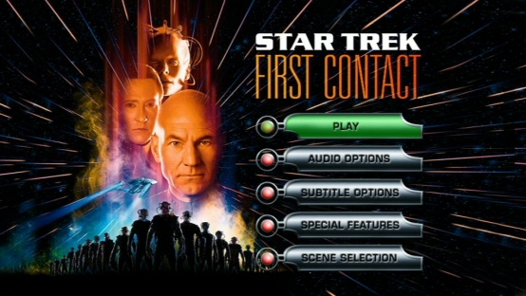
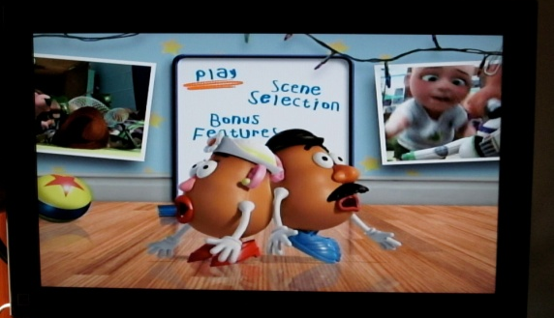
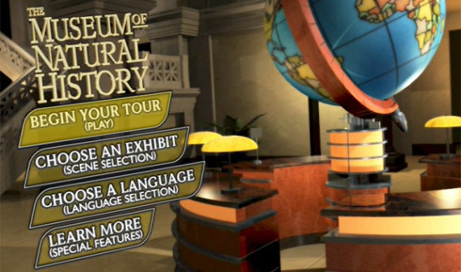
1.3 – Types of information access – DVD/Blu-Ray Menus
Style – Single screen, several image icons, ordered in priority, content based, interactive on rollover. Images are chosen from many, usually have short repeated video sequences.
Choice of background and selected images – Recognisable scenes, if scene selection then opens second menus or another screen, pixel depth is very high as not restricted by memory, preview scene should stand out against background and framed.
Navigation method - Rollover buttons, cursor controlled rather than point and click, makes popping sound when selection is being made, goes straight scene or second menu.
Intent – Start DVD or Video, show interactive features, plays music related to the content, often scroll down menus included for additional content.

Slide 19
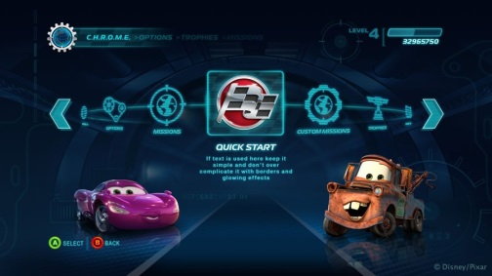
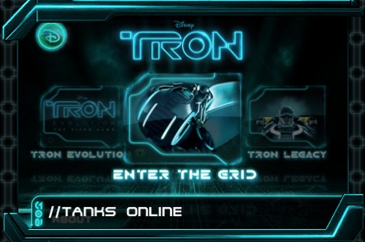
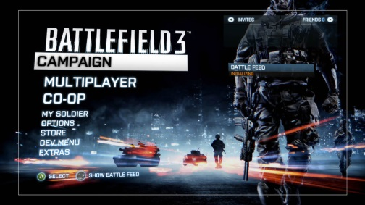
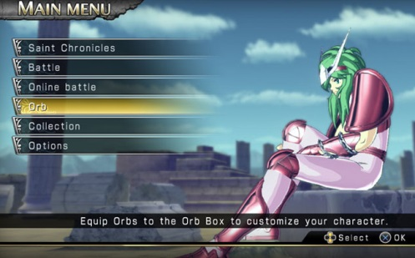
1.3 – Types of information access – Video Games
Style – Single screen pop-outs, several image icons at least usually related to the game content, ordered in standard priority, content based, interactive on rollover. Images are chosen from in game, usually have cursor links to highlight selection.
Choice of background and selected images – Recognisable scenes or faded version of current game screen, pixel depth is medium as restricted by memory, framed selection menus with faded transparency to reduce re-loading times. On puzzle games played screen is removed.
Navigation method - Rollover buttons, cursor controlled rather than point and click, makes popping sound when selection is being made, goes straight scene or second menu when selected.
Intent – Pause game to select something, change weapon, choose add ups or power ups, pause, alter character, change controls, to quit, save, load or restart.

Slide 20
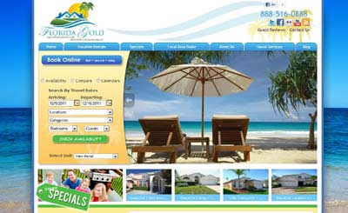
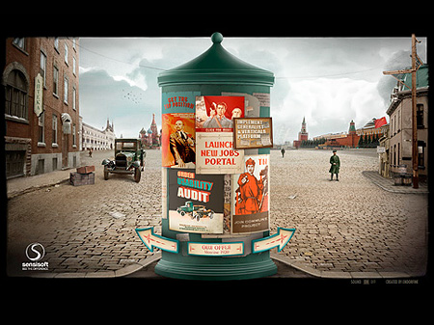
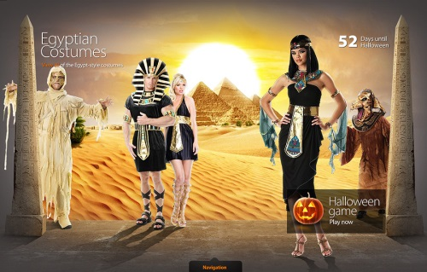
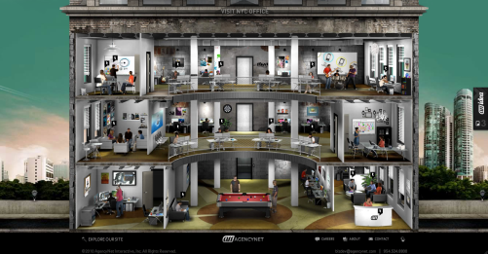
1.3 – Types of information access – Dynamic Websites
Style – Needs to impress in look and feel, needs to be unique, needs to be intuitive as well as reflect the company. Needs to be less like a website and more like a multimedia product. A small amount of sound as well as transitions, capable of downgrading for other devices.
Choice of background and selected images – Subject to site, High Quality to reflect intent, background must be interesting, images must be selective and replace text links. Capable of zooming and panning without breaking down, usually bitmap rather than vector.
Navigation method – mouse click only, rarely text linked, sometimes tab jumped. Interaction mouse over, transition to next page or web content.
Intent – To impress more than speed of content accessing. To be interesting, confusing, needs to engage from the outset, not expecting return visitors.

Slide 21
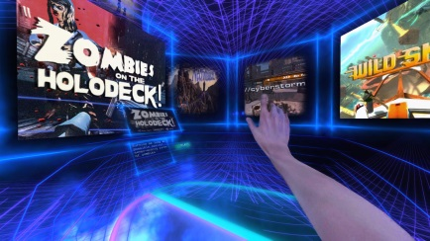
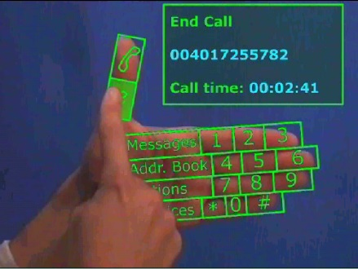
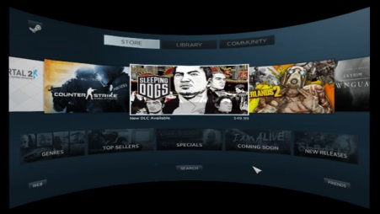
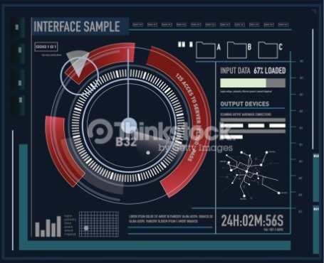
1.3 – Types of information access – Virtual Reality
Style – Needs to be cross screened (two sides), needs to be command or movement controlled, needs to appeal t a more engaged audience, needs to be smooth and easy to navigate.
Choice of background and selected images – Lower resolution due to limitations, transparent menus to reduce reloading times and viewers adjustment. Images are non textual to reduce reading. Background static during menu selection.
Navigation method – Simplified navigation, virtual hand selection or arrow selection because of instability. Not voice. Button cancellation, larger icons, nothing moving.
Intent – To replace screen activity, to immerse, to give a more wide view and interactivity for the user. To encompass which overrides glitches and lack of quality by replacing with interaction and physical movements.

Slide 22
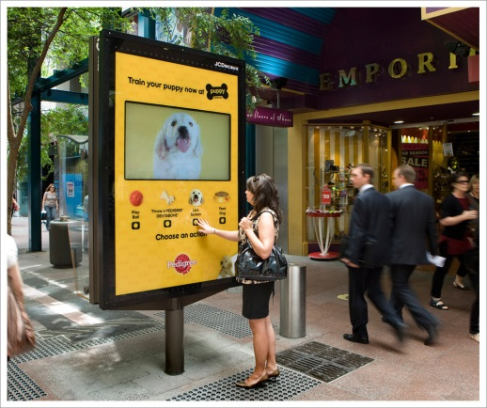
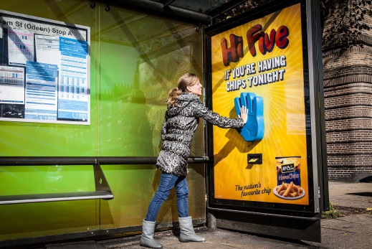
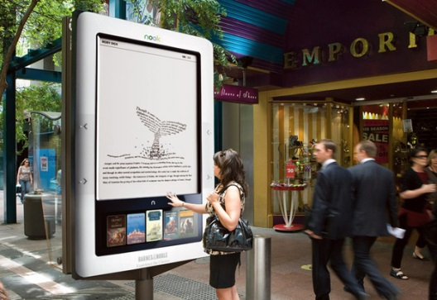
1.3 – Types of information access – Interactive Advertising
Style – Different ranges but generally pop ups Map points), arrow movements (dynamic ads), Alt tags (images with a lot of content), Flash based or game based (prize winning), outdoor adverts, must be short and easy to get through because of short attention span.
Choice of background and selected images – Usually flash so the images are crude or jpegs that are static and scrolled. Background static due to browser limitations. Images on scroll ads tend to be landscape and in keeping with theme, high res, not restricted by file size.
Navigation method – Mouse over on pop ups or rollover images, arrows left and right on image galleries, tab controlled when restricted to a few navigation icons.
Intent – To make ads more interesting, engage the user, show off capability, to reduce amount of content on page, to preview more images of a single product, to allow more products and information.

Slide 23
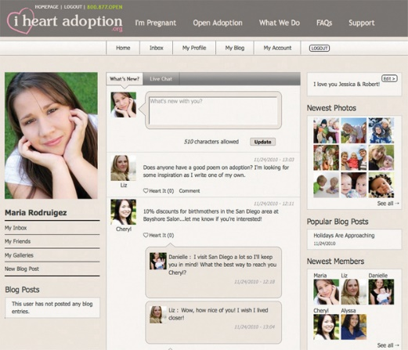
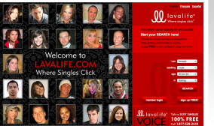
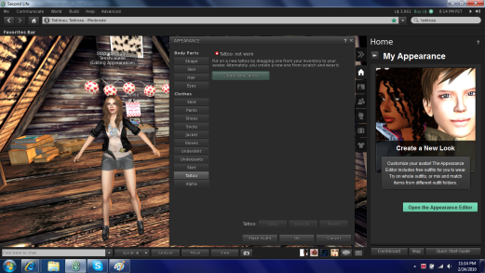
1.3 – Types of information access – Social networking Interface
Style – Cluttered, everything easily accessible, corporate colours, allows customisation, place for ads, nav. bar to show updates, messages and new links. Multiple scroll sections to reduce subpages, small text, highlighted areas with bordered categories.
Choice of background and selected images – Static coloured background, reduced gif images for screen content, all linkable images to larger Jpegs, often image links to pop outs to view more content. Colour sections to distinguish areas.
Navigation method – Multiple links, mouse and tab controlled, too many for keyboard shortcuts, scroll bars for added content like scrolling through messages or friends. Pop out menus for sub links, nav-bar at top and left of screens.
Intent – To communicate information, to stay in touch, to show content, to share, to be in keeping with the theme, to minimise the interruption to the main theme.

Slide 24
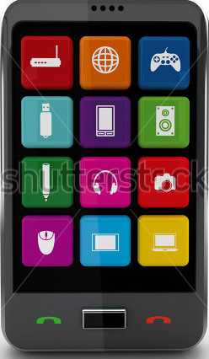
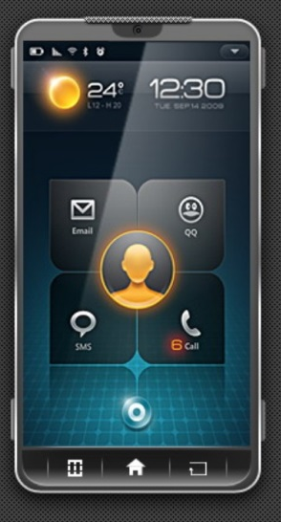
1.3 – Types of information access - Smart Phone Interface
Style – Reduced quality and content size, has sub pages for additional content. Icons are small, 60px by 60px. Set in grid, capable of being viewed landscape so grid rotated but stays the same number. Sometimes has zoom but graphic content does not change in resolution.
Choice of background and selected images – Corporate, recognisable, framed in 60x60, ico files similar to Windows and Mac, bevelled to stand out, choice of background image file, resolution reduced to maintain loading and refresh times.
Navigation method – Touch screen, finger swipe, multiple screens, multi-capacitive, can be re-arranged, most common uses at the bottom for quicker access. Menus are scroll with sub menus rather than pop outs.
Intent – To allow navigation and selection, to jump straight in, remove windows inter=face and mouse pointers.

Slide 25
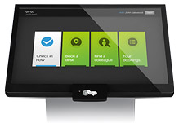
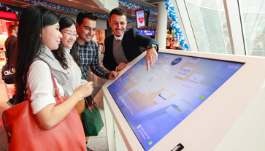
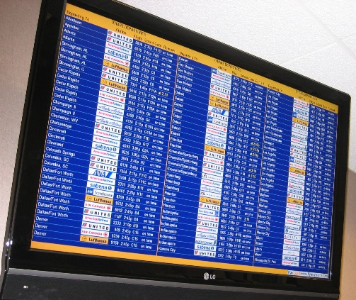
1.3 – Types of information access – Delivery Format
The ultimate output and location of the resource you create can have an impact on what you create and how it is viewed and used. The resources your audience uses can have an impact in terms of size, quality, interface, content and accessibility.
Web – there are certain files formats things need to be saved in, PHP, Flash, web embedded etc. which can impact not only on the program you use to make the product but the way the product is controlled. Tablets are touch sensitive but computer screens are not so the designer has to incorporate both into the interface. Screen size also has an impact, sound and OS compatibility. Then there are Java enabled browsers, school restricted sites, and accessibility issues, all of which have to be taken into consideration.
Multimedia, CD/DVD ROM, kiosks – these have major restrictions on usage, Kiosks are usually touch screen but have to be designed for all target audiences but have to be short term, easy to use and accessible. Multimedia means they can have sound and language barriers to overcome, and can overestimate or underestimate the age range of the audience. CD and DVD means the file size is restricted to 66oMB or 4.7GB, but it also means it is limited to a computer rather than tablet and requires some degree of technical knowledge to install and run, can be easily damaged and be restricted in the number of people using it at any one time.

Slide 26
1.3 – Types of information access – Delivery Format
Interactive TV – this can be a menu or a game, which means it is controlled by the users remote which is not designed as a game playing device, works off infra red, can be unresponsive or under sensitive and needs to be aimed in the right direction. The menu can be more intuitive but the audience is aimed at a younger age. The quality and content are also restricted due to lack of on-board memory and appeal.
Mobile devices – With more modern phones an tablets, the quality is less of a restriction as it used to be but the screens are smaller therefor the screen resolution and movement is less quality than a computer. There is also the issue with compatibility. On the plus side the screens are touch sensitive and though this means they are not as precise, they are more logical to the younger generation in their expected use. Memory capacity is a bigger issue, unlike games machines like PSP or DS, mobiles have a small amount of available memory to play and run interactive content and those that come off the website have to be customised specifically to take screen size and memory into consideration.
Task 9 – Using examples, discuss the hardware limitations and browser issues that need to be considered within a production for Information sharing.
Web | Multimedia, CD/DVD ROM, kiosks | Interactive TV | Mobile devices

Slide 27
1.4 – The Internet – Net vs. Web
Many people use the terms Internet and World Wide Web (aka. the Web) interchangeably, but in fact the two terms are not synonymous. The Internet and the Web are two separate but related things.
What is The Internet?
The Internet is a massive network of networks, a networking infrastructure. It connects millions of computers together globally, forming a network in which any computer can communicate with any other computer as long as they are both connected to the Internet. Information that travels over the Internet does so via a variety of languages known as protocols.
What is The Web (World Wide Web)?
The World Wide Web, or simply Web, is a way of accessing information over the medium of the Internet. It is an information-sharing model that is built on top of the Internet. The Web uses the HTTP protocol, only one of the languages spoken over the Internet, to transmit data. Web services, which use HTTP to allow applications to communicate in order to exchange business logic, use the Web to share information. The Web also utilizes browsers, such as Internet Explorer or Firefox, to access Web documents called Web pages that are linked to each other via hyperlinks. Web documents also contain graphics, sounds, text and video.
The Web is a Portion of The Internet
The Web is just one of the ways that information can be disseminated over the Internet. The Internet, not the Web, is also used for email, which relies on SMTP, Usenet news groups, instant messaging and FTP. So the Web is just a portion of the Internet, albeit a large portion, but the two terms are not synonymous and should not be confused.
Being without a USB stick now is rare Capacity is growing but size is shrinking !5 years ago 256mb was considered large SD cards are similar but smaller. Can be used as key loggers Becoming more discreet Are banned from a lot of government buildings.

Slide 28
1.4 – The Internet – Connection Methods
Being without a USB stick now is rare Capacity is growing but size is shrinking !5 years ago 256mb was considered large SD cards are similar but smaller. Can be used as key loggers Becoming more discreet Are banned from a lot of government buildings.

Slide 29
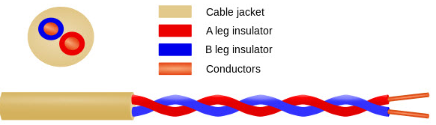
1.4 – The Internet – Connection Methods
There are different types of connection to the Internet you can be asked about in the exam, along with the advantages and disadvantages of each.
Dial-up
This is where it all started. You would take your home or office phone handset, and put it into a cradle called a modulator/demodulator, or modem as we know them today.
The modem took digital signals from your computer and turned them into audible sounds that would get transmitted though the mouthpiece of the handset. Off the signal would go over ordinary telephone wires to the computer that was acting as your Internet service provider. The signal coming back from the Internet would be played into the ear-piece of the phone and the modem would translate that audible signal into a digital signal that the computer could work with.
That is the essence of how all Internet communications go between your computer and wherever on the Internet your communicating with. What’s changed is the medium which these signals travel through, and the signal itself.
With the dial-up modem, the signal was analog and the medium was a phone line made of a pair of copper wires. This was the “tin can and string” of the Information Superhighway, but it was the best (and only) method there was for a long, long time. Below is a diagram of the basic twisted pair of cable that phone systems use.
How the Internet is so easily accessible now How long you have been without Internet access Places where there is no signal What are Satellite phones Can be used as key loggers Becoming more discreet Are banned from a lot of government buildings.

Slide 30
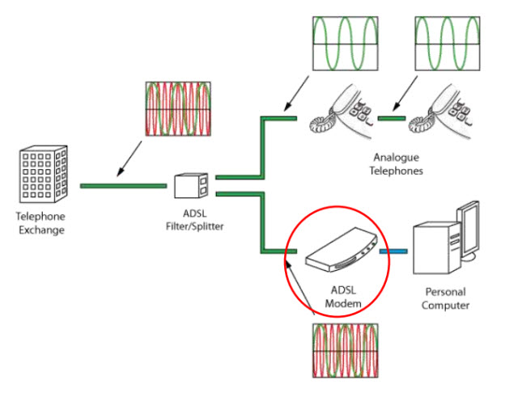
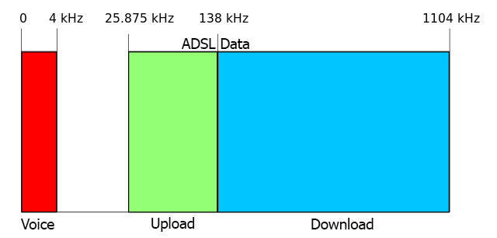
1.4 – The Internet – Connection Methods
DSL (Telephone Line)
DSL is an initialization of Digital Subscriber Line. The phone companies developed a way to send a second signal down the phone lines, and they did this by sending it at a higher frequency.
In real life, this is done by a signal filter. If you have DSL service, you know what these look like. It filters out the high frequency so you can hear the voice better. Otherwise there would be a high-pitched hiss on the phone line.
What You Can Expect: DSL ISPs promise speeds from 1.5 Mbps to 10 Mbps, however new technology could push it to 100 Mbps. A more realistic number is about 80-90% of what your ISP advertises. DSL service cost range widely, as the speeds do, from $20 USD to $120.
How the Internet is so easily accessible now How long you have been without Internet access Places where there is no signal What are Satellite phones Can be used as key loggers Becoming more discreet Are banned from a lot of government buildings.

Slide 31
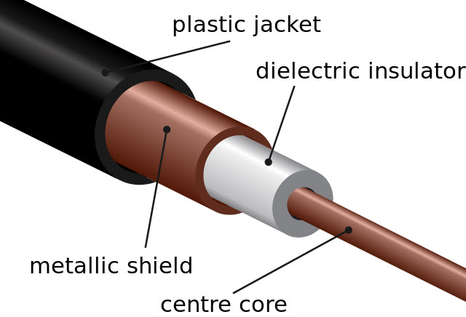
1.4 – The Internet – Connection Methods
Cable (Coaxial Cable)
When Internet access made the jump from dial-up, cable was the first new medium to be used. The cable used is the same as the cable that you may have for cable TV. One of those round cables, with a solid copper wire core inside of a thick plastic like insulator. Around the insulator there is usually a foil shield with a braided aluminum jacket around that. All of that is inside the outer plastic jacket of the cable.
The beauty of cable was that many homes already had it. Coaxial cable had been used for decades to send multiple signals, why not add Internet?
Delivering Internet access over cable uses a standard called Data Over Cable Service Interface Specification (DOCSIS). This method isn’t a whole lot different than what DSL does by using a high frequency for data and a low frequency for voice. Cable, however, uses many different frequencies – one for each channel. The oversimplified explanation of how DOCSIS works is that they added another channel (or frequency) for data. Cable can also use asynchronous data transmission, like DSL does.
How the Internet is so easily accessible now How long you have been without Internet access Places where there is no signal What are Satellite phones Can be used as key loggers Becoming more discreet Are banned from a lot of government buildings.

Slide 32
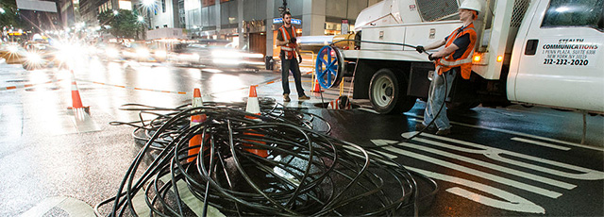
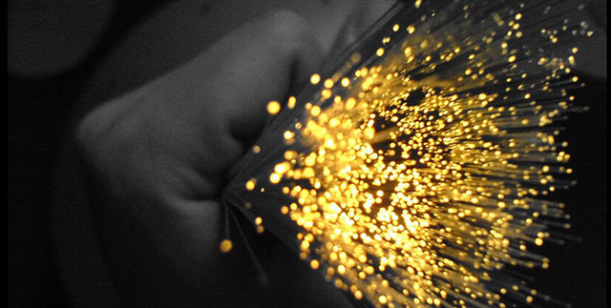
1.4 – The Internet – Connection Methods
Fibre Optic
The technologies that we’ve talked about so far use electricity and copper wires to transmit the signal. Then along comes fiber optics. In it’s simplest terms, the signal is light and the medium is a special type of flexible glass or clear plastic cable.
There is a transmitter on one end that converts the electrical signal to light. It pulses, in a similar way to how Morse Code pulses. The light travels down the glass cable to a receiver at the other end. The receiver detects the light and generates an electrical signal that your computer can use.
Light actually travels faster than electricity. Unfortunately, fiber networks are not as inexpensive or simple to install and run as wire-based networks. That’s why it’s most often used for large trunks on the Internet between major cities and across oceans.
How the Internet is so easily accessible now How long you have been without Internet access Places where there is no signal What are Satellite phones Can be used as key loggers Becoming more discreet Are banned from a lot of government buildings.

Slide 33
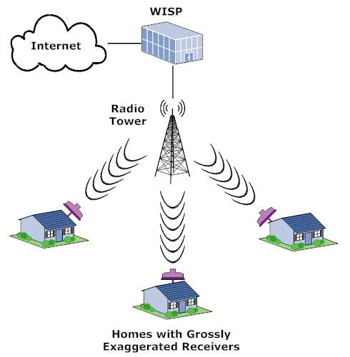
1.4 – The Internet – Connection Methods
Wireless Broadband
When ISPs advertise wireless broadband for your home, this is usually the type that they are talking about. The ISP will connect to the Internet through a cabled connection and then broadcast that connection using radio waves. You, as the customer, would have some sort of antenna and modem set up that would let you communicate with the ISP.
These systems work almost identically to cordless phones, even on the same frequencies that cordless phones do. The ISP just broadcasts with higher power so the signal will travel further. The one challenge is that your antenna needs to have a clear line-of-sight to their antenna. If there are trees or buildings in the way, you will get little to no service.
Wireless broadband is almost always only considered an option when you don’t have cable or DSL service to your home.
The service speeds with wireless broadband aren’t nearly as fast as with fiber or cables, for the same reason that your WiFi isn’t as fast as being connected to a network cable.
How the Internet is so easily accessible now How long you have been without Internet access Places where there is no signal What are Satellite phones Can be used as key loggers Becoming more discreet Are banned from a lot of government buildings.

Slide 34
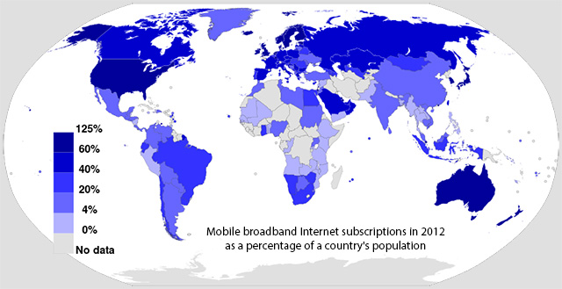
1.4 – The Internet – Connection Methods
Mobile Internet
This is how you get the Internet on your phone, USB stick, or PC cards that go in your computer. Service providers typically refer to it as Mobile Wireless Broadband, even though the term broadband isn’t technically being used correctly.
For a large part of the world, if you have cell phone service, you should be able to get mobile Internet service. Being available practically everywhere, and so many people having smartphones, there is an argument to be made that wireless Internet is the future.
Mobile Internet works with radio waves, similar to wireless broadband. Most people don’t realize that their cellphones are actually a type of radio. Over the years, service providers have figured out a way to transmit voice and data at the same time. There are several different ways that data can be sent over the cell signal. You’ve heard the terms 3G, 4G, and more recently, LTE. Each of those methods has a different way of sending data. 3G is an older, slower method and LTE is the newer faster method.
How the Internet is so easily accessible now How long you have been without Internet access Places where there is no signal What are Satellite phones Can be used as key loggers Becoming more discreet Are banned from a lot of government buildings.

Slide 35
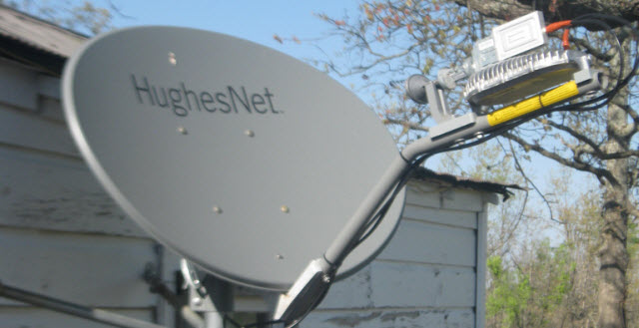
1.4 – The Internet – Connection Methods
Satellite Internet
As the name suggests, this is a way to get Internet access via a satellite dish. The signal gets beamed to a satellite which turns around and beams the signal to you, and vice versa. Like wireless broadband, it is a line-of-sight technology. Your dish needs to have a clear shot at wherever the satellite is in the sky.
Each transmission takes about a 45,000 mile trip between you, the satellite, and the ISP. From what we talked about earlier, you know that a signal traveling that far will get pretty weak. Attenuation. That’s part of why satellite Internet service isn’t usually your first choice. Another reason is that everyone in your area using satellite Internet has to share the same bandwidth. The area is the size of Utah or Ghana. That could be a lot of people. If you’re hogging the bandwidth, the ISP will slow your connection down to a crawl to give everyone else a chance.
How the Internet is so easily accessible now How long you have been without Internet access Places where there is no signal What are Satellite phones Can be used as key loggers Becoming more discreet Are banned from a lot of government buildings.

Slide 36
1.4 – The Internet – Connection Methods - Scenarios
Task 10 – For the following list of scenarios, specify the best type on Internet connection appropriate for the situation and state the reasons why, the advantages and disadvantages.
Charity worker in a disaster zone, following an earthquake when breaks in cables and optical fibres can disrupt information access
Home user just moved into a new house that currently does not have a live internet connection
Doctor within an ER looking for information to use within an operation
Students on a foreign field trip
Business who have gone live with a website that involves streaming videos
Postal worker using a handheld device to get customers to sign when a parcel is delivered
School providing limited Internet access within a 6th form centre
Restaurant setting up an Internet connection for customers
Café setting up a live video feed for the football for customers
How the Internet is so easily accessible now How long you have been without Internet access Places where there is no signal What are Satellite phones Can be used as key loggers Becoming more discreet Are banned from a lot of government buildings.

Slide 37
1.5 – Types of world wide web technology networks – The Internet
The Internet
The Internet is a worldwide collection of networks that allows users to:
Send and receive emails
Chat online (using text, voice, and/or video)
Transfer files form computer to computer (using file transfer protocols – ftp’s)
Browse the web.
In 2015 it was estimated that 3bn people use the internet across the world. The internet is not actually owned by any single person or company. It is a concept rather than something tangible (something that can be touched) and relies of a physical infrastructure that allows networks to connect to other networks.
The world wide web (www) is only part of the internet which users can access by the way of a web browser. It contains a massive collection of web pages and has been based on the hypertext transfer protocol (http) since 1989. This web is a way of accessing information over the medium known as the internet; the two terms ‘www’ and ‘internet’ are not the same thing.
What is WWW and how big is it? How do I get to the top of the Google search? What is a Digital Footprint? What is a MAC and IP address? How many sites are dedicated to cats? When I press enter on a search, how does it find stuff? What are Bots and should I be scared?

Slide 38
1.5 – Types of world wide web technology networks – Intranets
Many companies use an Intranet we well as the internet. An Intranet is defines as ‘a computer network based on internet technology but designed to meets the needs for sharing information within a single organisation or company.’ Access to an Intranet is usually confined to a company and, unlike the internet, is not available to the general public.
Intranets reside behind a firewall and are only accessible:
Internally to members of the company or
To people given various levels of access who are external to the company.
There are a number of reasons for adopting Intranets rather than using the internet:
Intranets are safer since there is less chance of external hacking or viruses
It is possible to prevent external links to certain websites.
Companies can ensure that the information available is specific to their needs
It is easier to send out sensitive messages in the knowledge that they will remain within the company.
Intranets offer better bandwidth than the internet thus there are fewer connection limits than the internet (the number of bits per second that can be transmitted are usually higher within an Intranet)
It is possible to create Extranets that allow Intranets to be extended outside the business but with the same advantages as an Intranet; this allows trading partners to have controlled access to some of the information (commercially sensitive information is password protected)

Slide 39
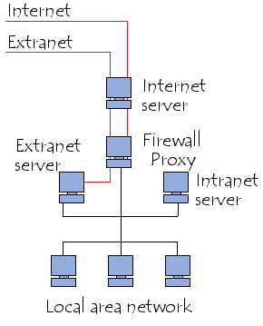
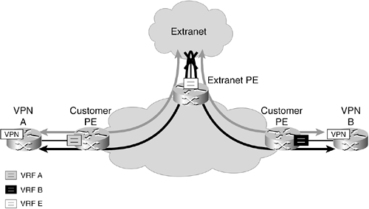
1.5 – Types of world wide web technology networks – Extranet
An Extranet is actually an Intranet that is partially accessible to authorised outsiders. The actual server (the computer that serves up the web pages) will reside behind a firewall. The firewall helps to control access between the Intranet and Internet permitting access to the Intranet only to people who are suitably authorised. The level of access can be set to different levels for individuals or groups of outside users. The access can be based on a username and password or an IP address (a unique set of numbers such as 209.33.27.100 that defines the computer that the user is on).
An extranet can be used to meet a variety of different needs. Large volumes of data can be exchanged between parties via extranets, for example, and they can also be used to create collaboration. The latter is especially useful for companies that need to brainstorm or work back and forth with clients and customers, and it can save hours of time in comparison to using email and/or telephone. Extranets are also used to help monitor and fix any potential bugs or issues that can occur with a company's products or services — almost like built-in quality control.

Slide 40
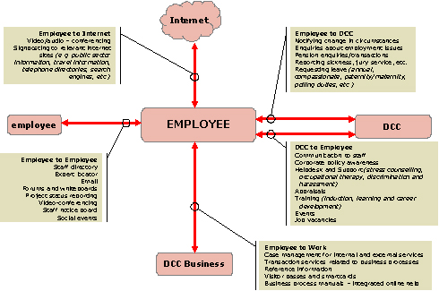
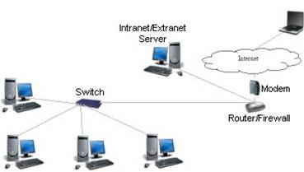
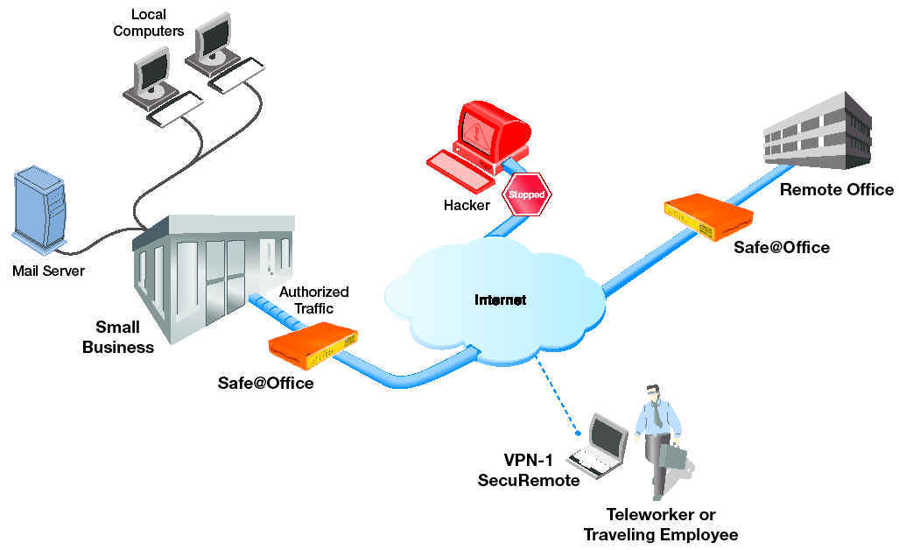
1.5 – Types of world wide web technology networks – Extranet
Intranets
Extranets
Many large companies have an extranet to allow employees to work from home on a secure network.

Slide 41
1.6 – World wide web information terminologies
There is a lot of terminology within IT that may come up as a question if some form.
Task 12 - For each of the following definitions you need to expand on them, by research into further examples of each information format, describing how each format meets the need of a range of different holders of information.
Backbone - A high-speed line or series of connections that forms a major pathway within a network.
Bandwidth - How much data that can be sent through a network connection (usually Internet). A 56k Dial-Up Modem can send about 57,000 bits in one second. Modern DSL connections are capable of transfers of 100Mbits (100,000,000 bps)
Blog - Short for web-log. An web-based journal.
Browser - Special software designed to read web pages. Often referred to as a Web Browser.
Client - A piece of software designed to contact and obtain data from a Web Server. An Email Client or Browser Client are examples.
Client-Side - Any requirement or procedure that relies upon and executes on the users computer. This basically means the hardware/software set-up being used by a visitor to a website. See: Server-Side.
Cookie - A small file sent by a Web Server (usually through a website) to a Web Browser which is saved on the users computer. This file can then be referenced when the user revisits the same Web Sever (website).
What is WWW and how big is it? How do I get to the top of the Google search? What is a Digital Footprint? What is a MAC and IP address? How many sites are dedicated to cats? When I press enter on a search, how does it find stuff? What are Bots and should I be scared?

Slide 42
1.6 – World wide web information terminologies
CSS - Cascading Style Sheets. A standard for formatting the appearance of webpages, etc. In relation to 'Web Standards' and 'Semantics'. Used alongside HTML, XML, XHTML, etc.
DHTML - Dynamic HyperText Markup Language. The unofficial name given to webpages that combine HTML, JavaScript, and CSS technologies.
DNS - Domain Name System. The system that translates Internet domain names into IP numbers.
Domain Name - The unique name that identifies an Internet based website. Example: www.yourdomain.com
Domain Registrar – Company that enables customers to register domain names and hosting services.
FTP - File Transfer Protocol. Common method for transferring files between computers via the Internet.
Host - A computer that stores and serves web pages over the Web. Most people rent web space for their website from specialist 'Hosting' providers.
HTML - Hyper Text Mark-Up Language. Standard Mark-Up coding language for creating web pages. It is the source code that the computer reads to create the page. See: HTTP
HTTP - Hyper Text Transfer Protocol. Standard protocol for addressing Hyper Text web pages on the web. See: HTML
What is WWW and how big is it? How do I get to the top of the Google search? What is a Digital Footprint? What is a MAC and IP address? How many sites are dedicated to cats? When I press enter on a search, how does it find stuff? What are Bots and should I be scared?

Slide 43
1.6 – World wide web information terminologies
IP Address or Number - Internet Protocol. Every computer that accesses the Internet must have a unique identifying number.
ISP - Internet Service Provider. Companies that provide a means for their users to access the Internet.
Java - Sophisticated programming language developed by Sun Microsystems. Used often on the Web because, unlike other languages (C++), it is not system or platform dependent. (i.e. Windows, Linux, Mac, Unix).
JavaScript - Scripting language often used on webpages. Not to be confused with Java.
Keywords - Meta Tag used in HTML. Used to identify/describe the purpose of a web page. Search Engines use this information when indexing. Sometimes used as a general term to describe words you wish to target as part of SEO.
Linux - Computer operating system. An open source system developed to run on desktop PC's, servers, etc.
Meta Tags - Tags used in HTML that are not displayed in the resulting webpage. Used to identify/describe the purpose of a webpage. Search Engines can use this information when indexing.
MySQL - Open-Source sever-side database technology, often used in conjunction with PHP.
What is WWW and how big is it? How do I get to the top of the Google search? What is a Digital Footprint? What is a MAC and IP address? How many sites are dedicated to cats? When I press enter on a search, how does it find stuff? What are Bots and should I be scared?

Slide 44
1.6 – World wide web information terminologies
Open Source - Any kind of computer software, program, application, script, etc, who's source code can be legally viewed and modified. Software that is often developed by a community. Open Source software is usually free to use.
RSS – A method of communication large amounts of information in a BBS format for a selected audience.
PHP - Popular Open-Source 'middleware' scripting/programming language used to build 'web applications'.
SEO - Search Engine Optimisation. A technique for making a website Search Engine 'friendly'.
SMTP - Simple Mail Transfer Protocol. Common protocol used to send email from server to server via the Internet.
SQL - Structured Query Language. A language for sending queries to databases.
SSL - Secure Socket Layer. Protocol to enable encrypted communications across the Internet,
Unix - Operating System often used on Server computers.
URL - Uniform Resource Locator. At its simplest, URL can be seen to be synonymous with a 'web address'.
Web host -the computer that has the ability to display the website on the World Wide Web so that everyone can see it worldwide.
Web Server- a computer that is only used to display websites and webpages.
What is WWW and how big is it? How do I get to the top of the Google search? What is a Digital Footprint? What is a MAC and IP address? How many sites are dedicated to cats? When I press enter on a search, how does it find stuff? What are Bots and should I be scared?

Slide 45
1.7 – Accessibility of world wide web information formats
The Web is fundamentally designed to work for all people, whatever their hardware, software, language, culture, location, or physical or mental ability. When the Web meets this goal, it is accessible to people with a diverse range of hearing, movement, sight, and cognitive ability.
Thus the impact of disability is radically changed on the Web because the Web removes barriers to communication and interaction that many people face in the physical world. However, when websites, web technologies, or web tools are badly designed, they can create barriers that exclude people from using the Web.
When will the web have Braille Text to voice for Internet pages. Can you name 4 accessibility options on websites. There are 3 colour blind types, name them. Different kinds of keyboards. Will VR be the next big thing in terms of accessibility

Slide 46
1.7 – Accessibility of world wide web information formats
First consider the problem, how can a person with limited mobility, sight, hearing and knowledge use the Internet as the majority of people. Consider how these can be addressed and enable web accessibility. Some examples are alt tags, alternative content, alter text size, alter colours used, image file size
Interesting articles about web accessibility:
http://en.wikipedia.org/wiki/Web_accessibility
http://www.w3.org/WAI/intro/accessibility.php - very good
http://www.w3.org/WAI/
People can have many different disabilities which could affect web accessibility:
Visual
Short /long Sight
Restricted field of view or Obstructed vision (e.g. - tunnel vision)
Colour Blindness
Cognitive disabilities
Remembering how to operate or where to find areas of the website
Hearing Disabilities
Physical ailments – Which could mean traditional mouse and keyboard operation is difficult
Task 13 – Research, describe and present how different visual, motion and cognitive disabilities can affect internet use.
When will the web have Braille Text to voice for Internet pages. Can you name 4 accessibility options on websites. There are 3 colour blind types, name them. Different kinds of keyboards. Will VR be the next big thing in terms of accessibility

Slide 47
1.7 – Accessibility of world wide web information formats
How do we get around these problems?
Special keys to control the Keyboard
Mouse Keys
Sound Sentry which gives visual indication of events which would normally be given by sound
Ways to change the screen colours and appearance
High Contrast Screens
Design the website to have hotspot or image links to reinforce navigation protocols
Other ways to increase accessibility exist in Windows are include:
A magnifier
A basic Screen Reader called Narrator
An on-screen keyboard
When will the web have Braille Text to voice for Internet pages. Can you name 4 accessibility options on websites. There are 3 colour blind types, name them. Different kinds of keyboards. Will VR be the next big thing in terms of accessibility

Slide 48
1.7 – Accessibility of world wide web information formats
Social Factors
Language barriers
Not understanding the written language hinders web accessibility.
Education
We take for granted what we know about the internet and how to use it. However there are many different social groups that have not been exposed to computers or the internet and as a result can not or are afraid to access these.
Cultural differences
Unwritten acceptable social norms and ‘ways of doing things’ could lead to alienation of different cultures.
For example the same products for the same company have very different web presences.
When will the web have Braille Text to voice for Internet pages. Can you name 4 accessibility options on websites. There are 3 colour blind types, name them. Different kinds of keyboards. Will VR be the next big thing in terms of accessibility

Slide 49
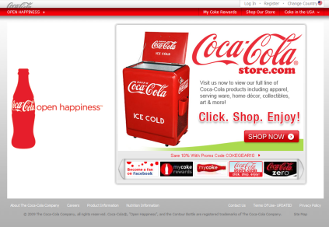
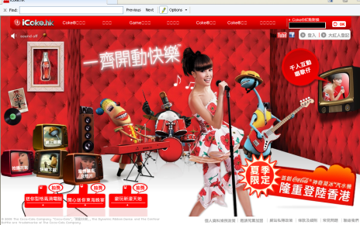
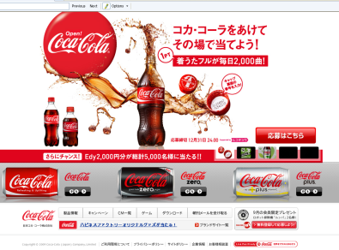
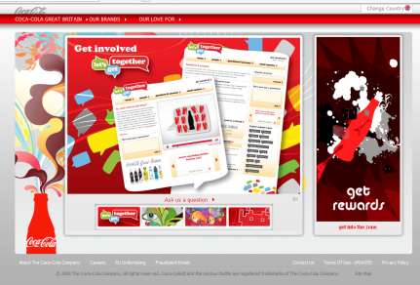
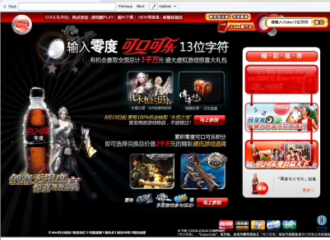
1.7 – Accessibility of world wide web information formats
How to address these
Having different language options is a relatively easy method of addressing web accessibility, alternatively using images would be universal.
Having clear and succinct help – possibly through flash animation or clear text.
Having different alternative sites which cater specifically to the different culture
http://www.coca-cola.com/index.jsp?cookie=false
Task 14 – Demonstrate your understanding of Web Accessibility by demonstrating the problem and used solution for web issues.
When will the web have Braille Text to voice for Internet pages. Can you name 4 accessibility options on websites. There are 3 colour blind types, name them. Different kinds of keyboards. Will VR be the next big thing in terms of accessibility
USA
Hong Kong
Japan
UK
P R of China

Slide 50
1.8 – Individuals of WWW Information Formats
Task 15 - Using the information from the holders of information, from 2.1, to identify at least 10 individual holders of information.
Research the potential advantages for individuals of using www technologies (networks and information formats).
Investigate the potential disadvantages for individuals of using www technologies by researching the consequences of the loss of personal data.
Present your findings, summarising the outcome of the research and draw out common ideas and research findings.
Holder of such information could include Students like yourself when doing a research project, a Teacher when resourcing materials for this Unit, a person in marketing using the Web for research in statistics etc.
When will the web have Braille Text to voice for Internet pages. Can you name 4 accessibility options on websites. There are 3 colour blind types, name them. Different kinds of keyboards. Will VR be the next big thing in terms of accessibility

Slide 51
1.9 – Individuals of WWW Information Formats
Task 16 - Using the information from the holders of information, from 2.1, to identify at least 10 individual holders of information. Select the most suitable media and devices for scenarios provided, and justify their selections. (see next slide)
Global divide resource: click here. Imagine carrying out the same tasks in Ghana (internet being slow and limited), South Korea (Internet being super fast and unrestricted), Saudi Arabia (Internet being monitored and limited), or Chile (Internet being unavailable except through satellite phones).
Task 17 – Using the global divide resource, reassess your knowledge of the technological divisions that exist in the world.
When will the web have Braille Text to voice for Internet pages. Can you name 4 accessibility options on websites. There are 3 colour blind types, name them. Different kinds of keyboards. Will VR be the next big thing in terms of accessibility

Slide 52
1.9 – Individuals of WWW Information Formats
Charity worker in a disaster zone, following an earthquake when breaks in cables and optical fibres can disrupt information access
Home user just moved into a new house that currently does not have a live internet connection
Doctor within an ER looking for information to use within an operation
Students on a foreign field trip
Business who have gone live with a website that involves streaming videos
Postal worker using a handheld device to get customers to sign when a parcel is delivered
School providing limited Internet access within a 6th form centre
Restaurant setting up an Internet connection for customers
Café setting up a live video feed for the football for customers
When will the web have Braille Text to voice for Internet pages. Can you name 4 accessibility options on websites. There are 3 colour blind types, name them. Different kinds of keyboards. Will VR be the next big thing in terms of accessibility

Slide 53
1.8 – Exam Questions – Specimen Paper
This section relates to the case study on Progress Vision.
1. The current Progress Vision website is basic. It uses static web pages and contains four information styles: text, graphics, animated graphics and video.
Progress Vision plans to make enhancements to its website. The aim is to raise awareness of the charity’s work and to increase donations.
(a) The enhanced website will use dynamic web pages instead of static webpages.
Explain one reason why Progress Vision would use dynamic webpages.
____________________________________________________________________________________________________________________________________
____________________________________________________________________________________________________________________________________
__________________________________________________________________
_______________________________________________________________ [2]
?

Slide 54
1.8 – Exam Questions – Specimen Paper
(b) Progress Vision uses data for many different purposes.
Identify two ways in which Progress Vision could use its data.
1. ________________________________________________________________
2. _____________________________________________________________ [2]
(c) Identify three logical protection measures, other than obfuscation, that could be used by Progress Vision to help keep information secure. Justify why each of these measures would keep information secure.
1. ________________________________________________________________
__________________________________________________________________
__________________________________________________________________
__________________________________________________________________
2. ________________________________________________________________
__________________________________________________________________
__________________________________________________________________
__________________________________________________________________
3. ________________________________________________________________
__________________________________________________________________
__________________________________________________________________
______________________________________________________________ [6]
?

Slide 55
1.8 – Exam Questions – Specimen Paper
(b) Explain one advantage and one disadvantage to the online retailer of using World Wide Web technologies.
Advantage_______________________________________________________________________________________________________________________________________________________________________________________________________________________________________________________________Disadvantage__________________________________________________________________________________________________________________________________________________________________________________________________________________________________________________________ [4]
7. Information is held by individuals and organisations globally.
(a) Explain one reason why working from home in a rural location might affect an individual’s ability to work remotely.
__________________________________________________________________
__________________________________________________________________
__________________________________________________________________
_______________________________________________________________ [2]
?

Slide 56
1.8 – Exam Questions – Specimen Paper
10. An international bank wants to improve its global image.
(a) The bank could use Green IT to enhance its brand image.
Describe one way in which Green IT could be implemented by the bank to improve sustainability.
__________________________________________________________________
__________________________________________________________________
__________________________________________________________________
_______________________________________________________________ [2]
(b) Explain one information-based technique that the bank could use for promotion and marketing.
__________________________________________________________________
__________________________________________________________________
__________________________________________________________________
__________________________________________________________________
__________________________________________________________________
_______________________________________________________________ [3]
?

